Slide 1
The Mantid Project for Data Reduction and Analysis
Mathieu Doucet Neutron Data Analysis and Visualization

Slide 2
Outline
History of the project
Key features & Design
EQSANS
Software environment
Lessons learned
What’s next?

Slide 3

Project Goals
Goals
Consolidate the data reduction/analysis software for neutron scattering without restricting the needs of the instrument scientists
Key requirements
Create a Data Analysis framework
Not instrument or technique dependent
Cross-platform
Windows, Linux, Mac
Easily extensible
Freely redistributable

Slide 4


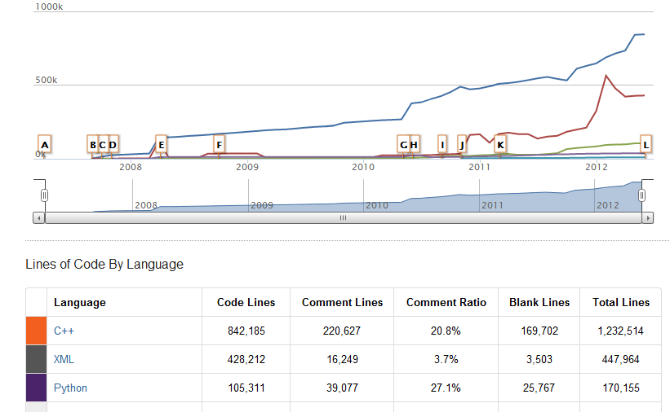

Project History
July 2007 Requirements & Design
April 2008 v1.0 First instrument support (ISIS)
April 2010 Collaboration with SNS & HFIR
Jan 2012 v2.0
Scientist validated results
May 2012
v2.1
Support for all SNS instruments
Today, about 20 developers are active on the project
Notes:
#LOC to give an idea of size of the project

Slide 5
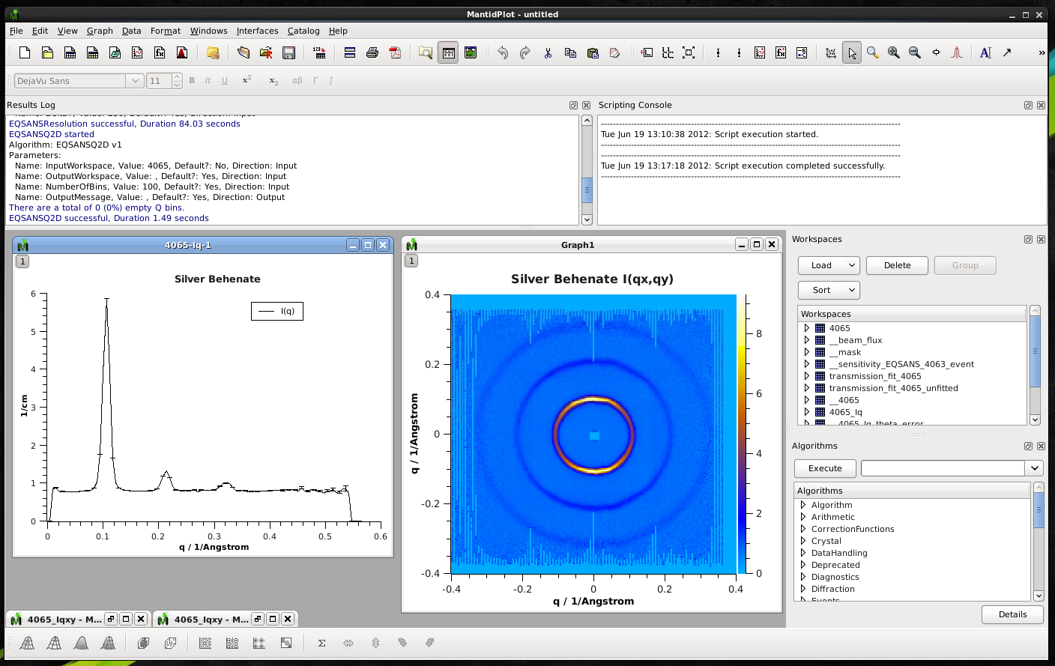
Analysis Environment
Logging
Scripting
Workspaces:
Event data & Logs
Plotting
Algorithms
Notes:
Workspace = list of events w/TOF
List of events means time filtering
Example of reduced EQSANS data
Scripting = flexibility for users to do much more than what the UI provides

Slide 6

Architectural Design Overview
Log files &
Instrument description
Mantid Framework
Python
Scripting
Algorithms
Workspaces
API
Data files
User Defined
MantidPlot Graphing and analysis
Separation of Data and Algorithms
Encapsulated “User Code” in specific places
Use of well designed interfaces to allow generic use of component
Scripting allows greater analysis flexibility
Instrument specific UI

Slide 7
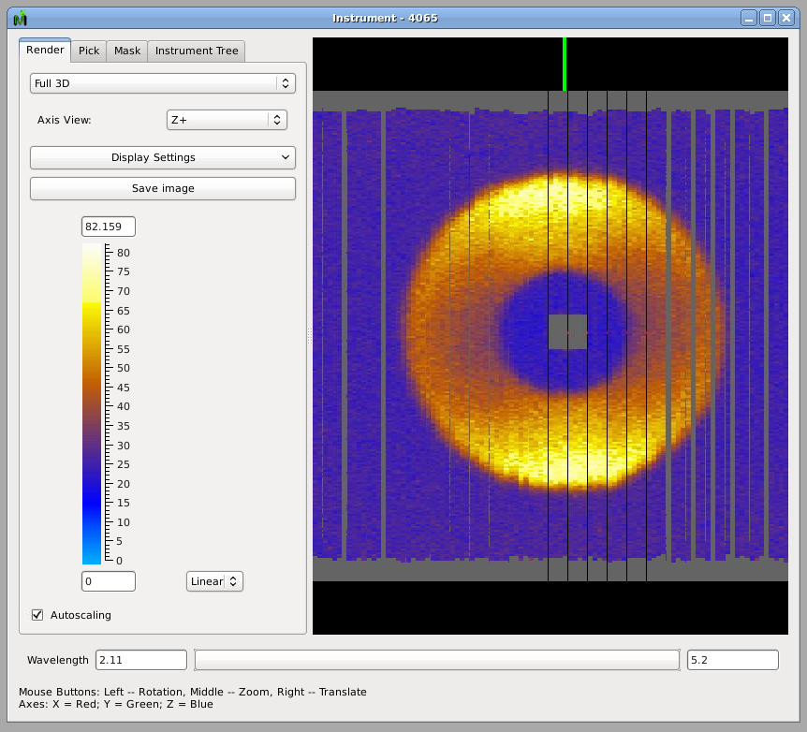
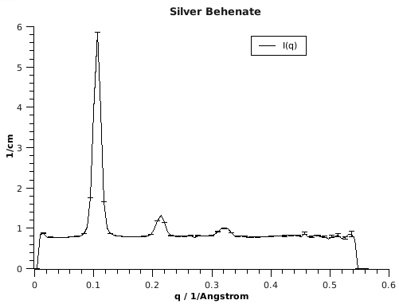
EQSANS Detector View
Reduction
Full wavelength
range
Notes:
Looking at the same data, but raw
TOF transformed to wavelength
The donut mostly corresponds to the peak at 0.1
Lower wavelength on the inside (lower angle), higher wavelength on the outside (higher angle) to result in the same Q

Slide 8
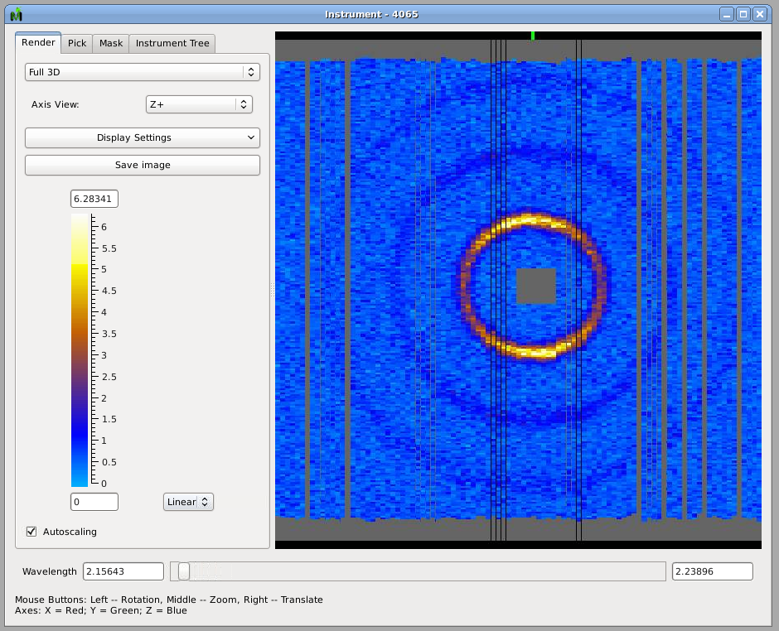
EQSANS Detector View

Slide 9

EQSANS Detector View

Slide 10

EQSANS Detector View

Slide 11

EQSANS Detector View

Slide 12
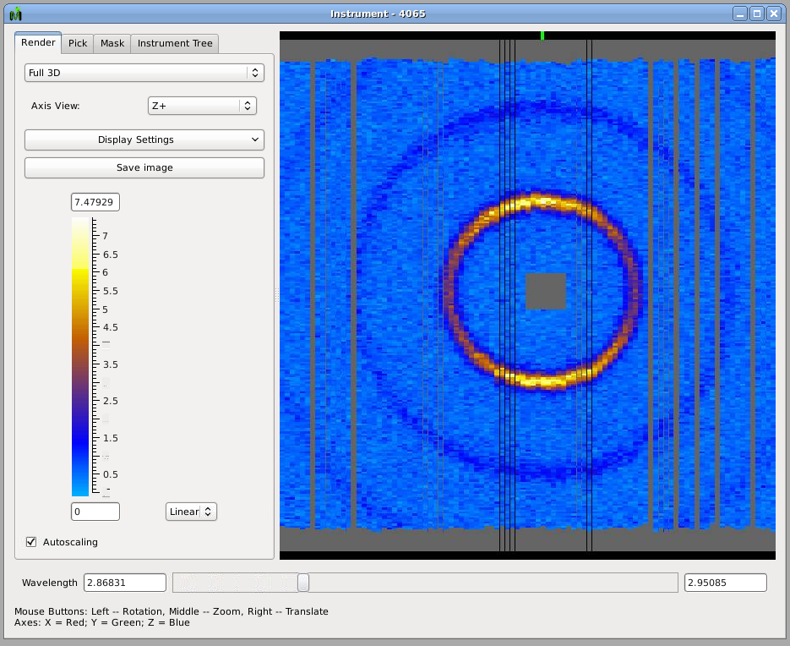
EQSANS Detector View

Slide 13

EQSANS Detector View

Slide 14
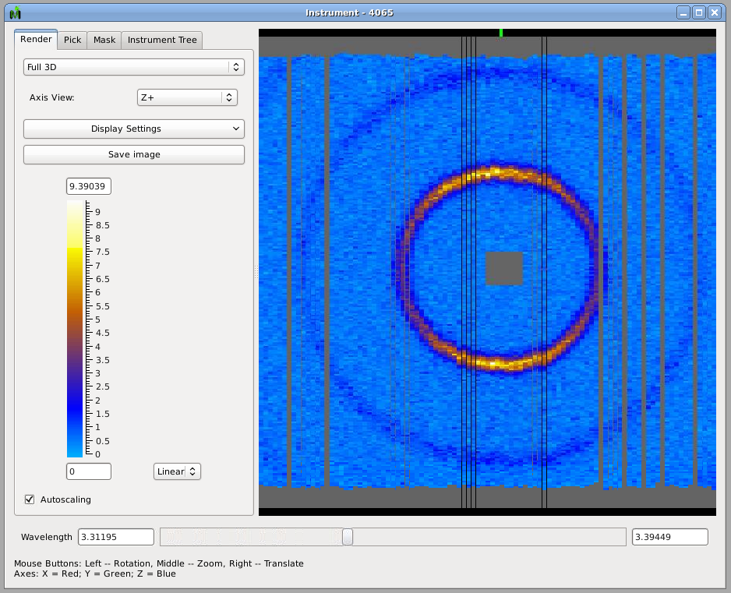
EQSANS Detector View

Slide 15
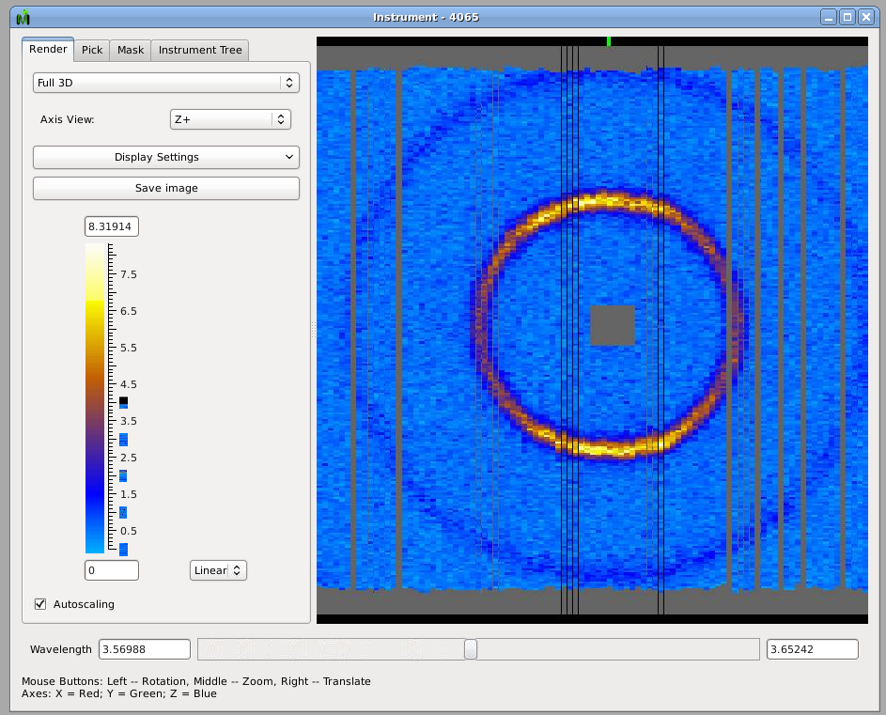
EQSANS Detector View

Slide 16
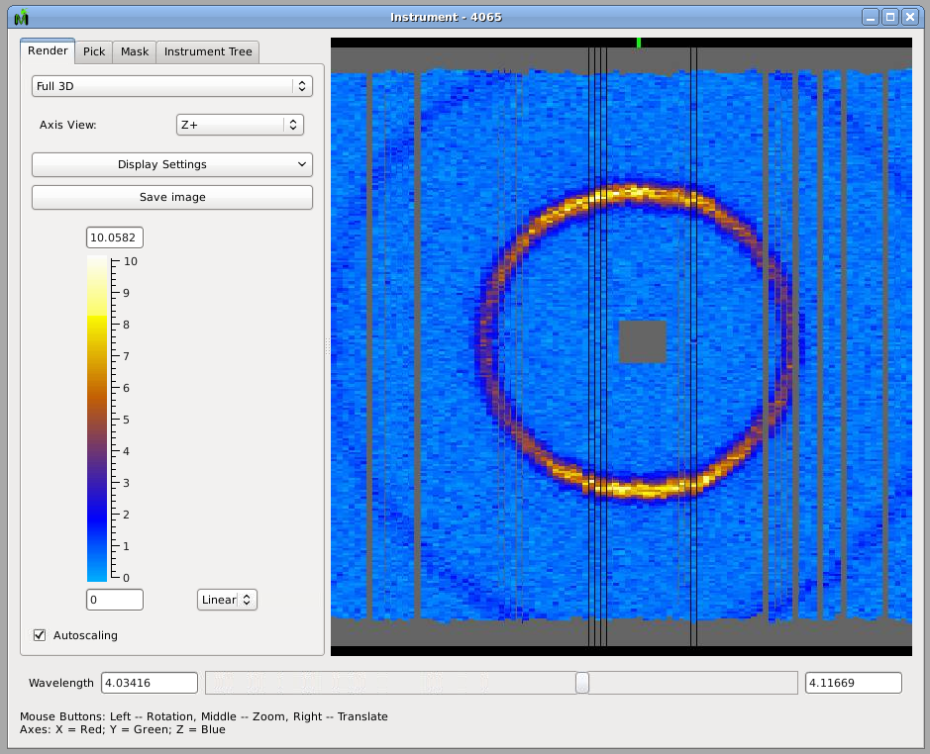
EQSANS Detector View

Slide 17
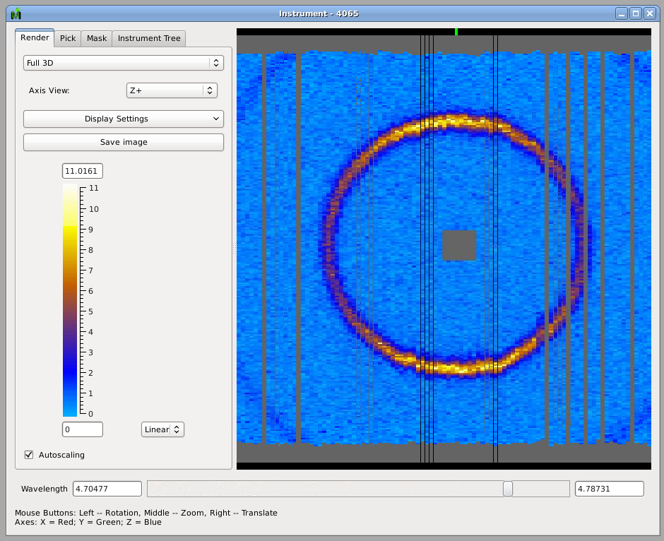
EQSANS Detector View

Slide 18
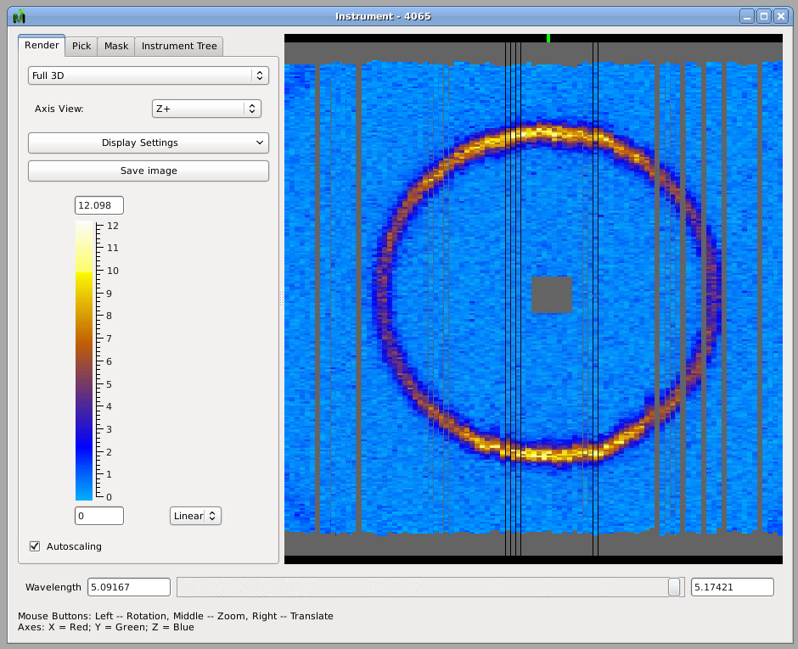
EQSANS Detector View

Slide 19
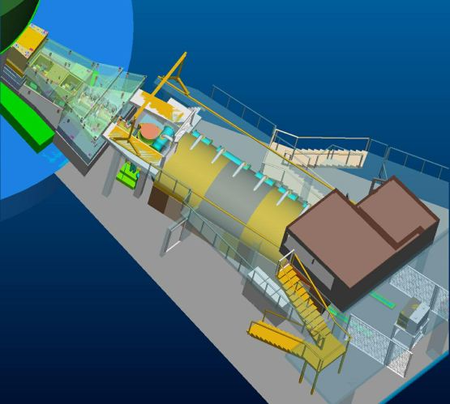
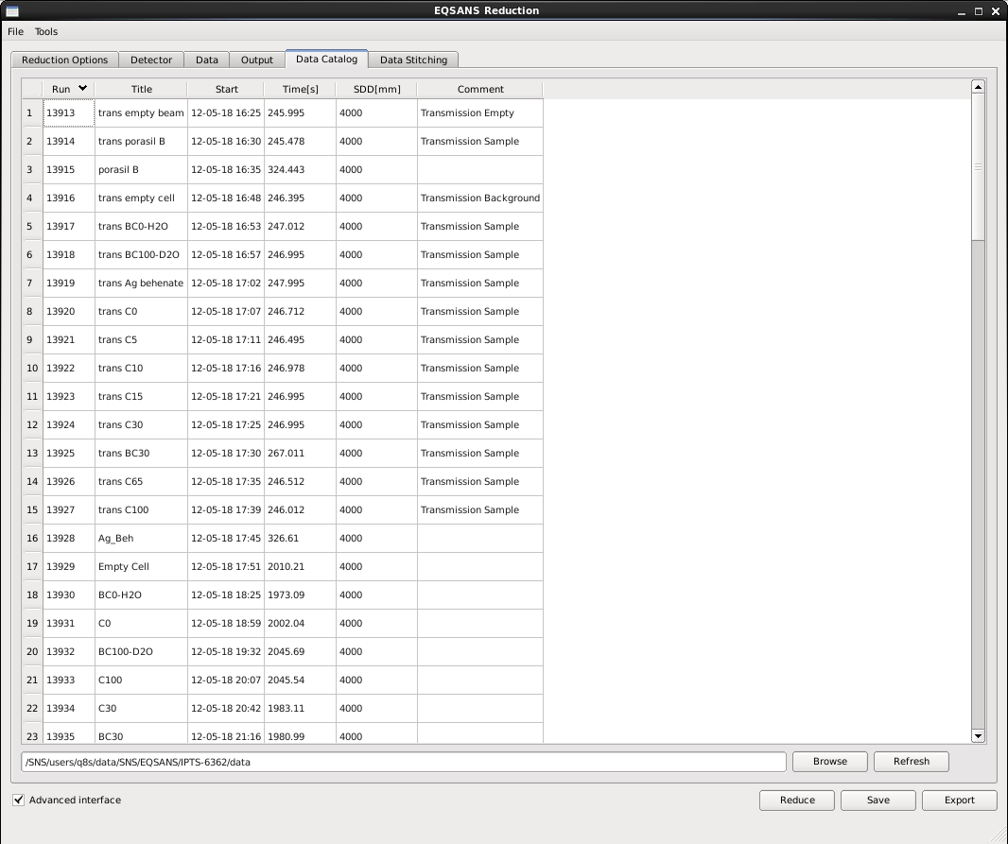
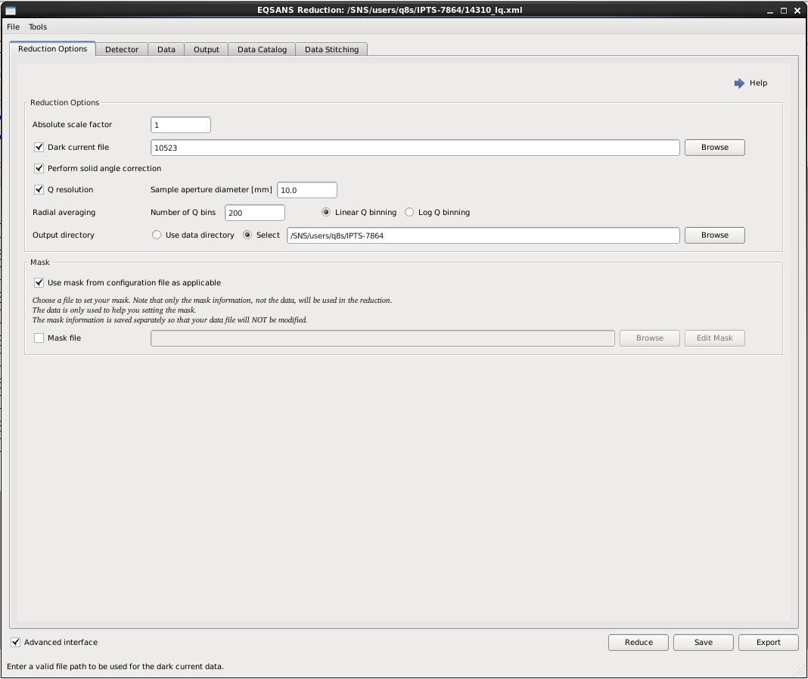
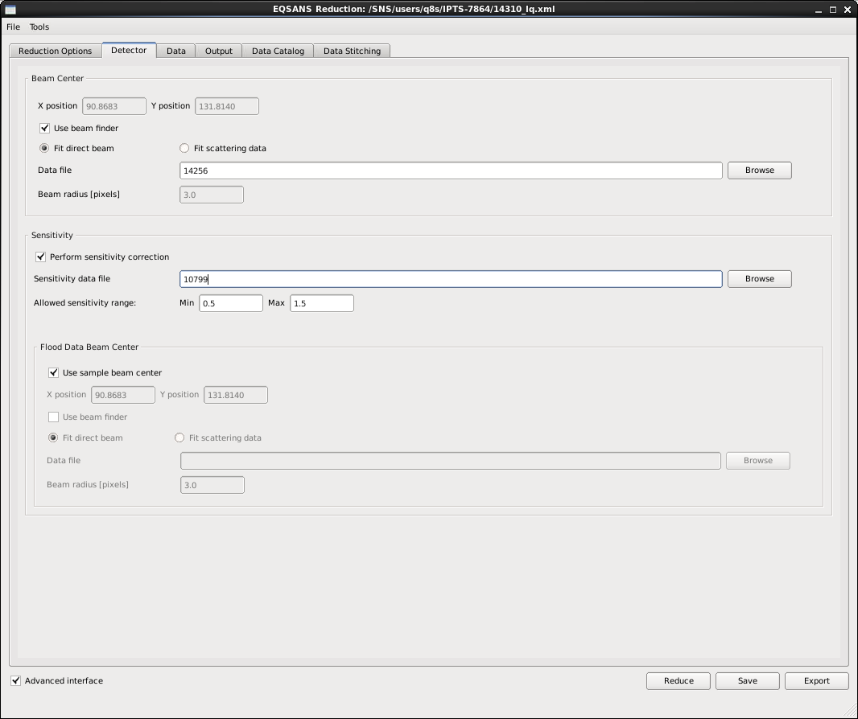
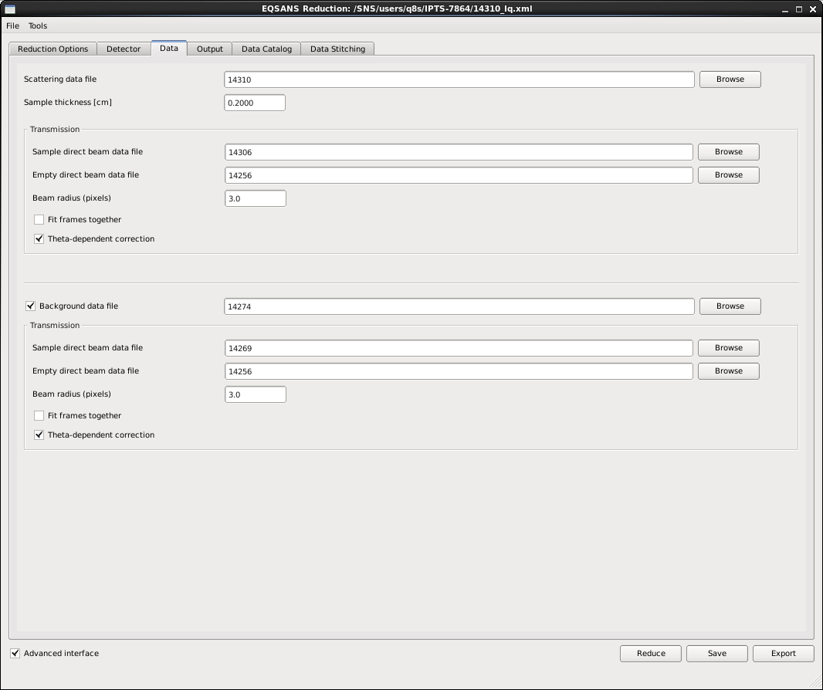
EQSANS Reduction
Dedicated user interface helps users set up their reduction
UI just composes the script for the user
SANS-specific scripting allows more flexibility, like event filtering
Notes:
UI just composes the script for the user

Slide 20
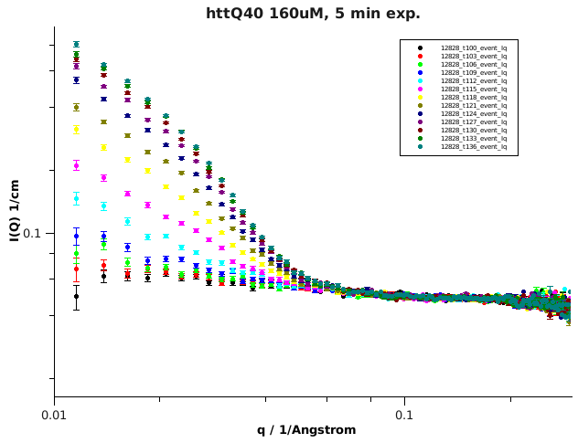
Contributions from Users
Users can export their reduction process as a python script after setting it up using the UI.
Users can then modify that script to suit their needs.
Those script are often kept, cleaned and reused by the instrument team to support other users.
Original script by Vivek Prabhu (NIST)
Huntington’s Disease
huntingtin (httQ40) aggregation followed by time-resolved SANS.
Stanley, C.B.; Perevozchikova, T.; Berthelier, V. Biophys. J. 100, 2504-2012 (2011).
Data by Chris Stanley (ORNL)
Notes:
UI just composes the script for the user

Slide 21
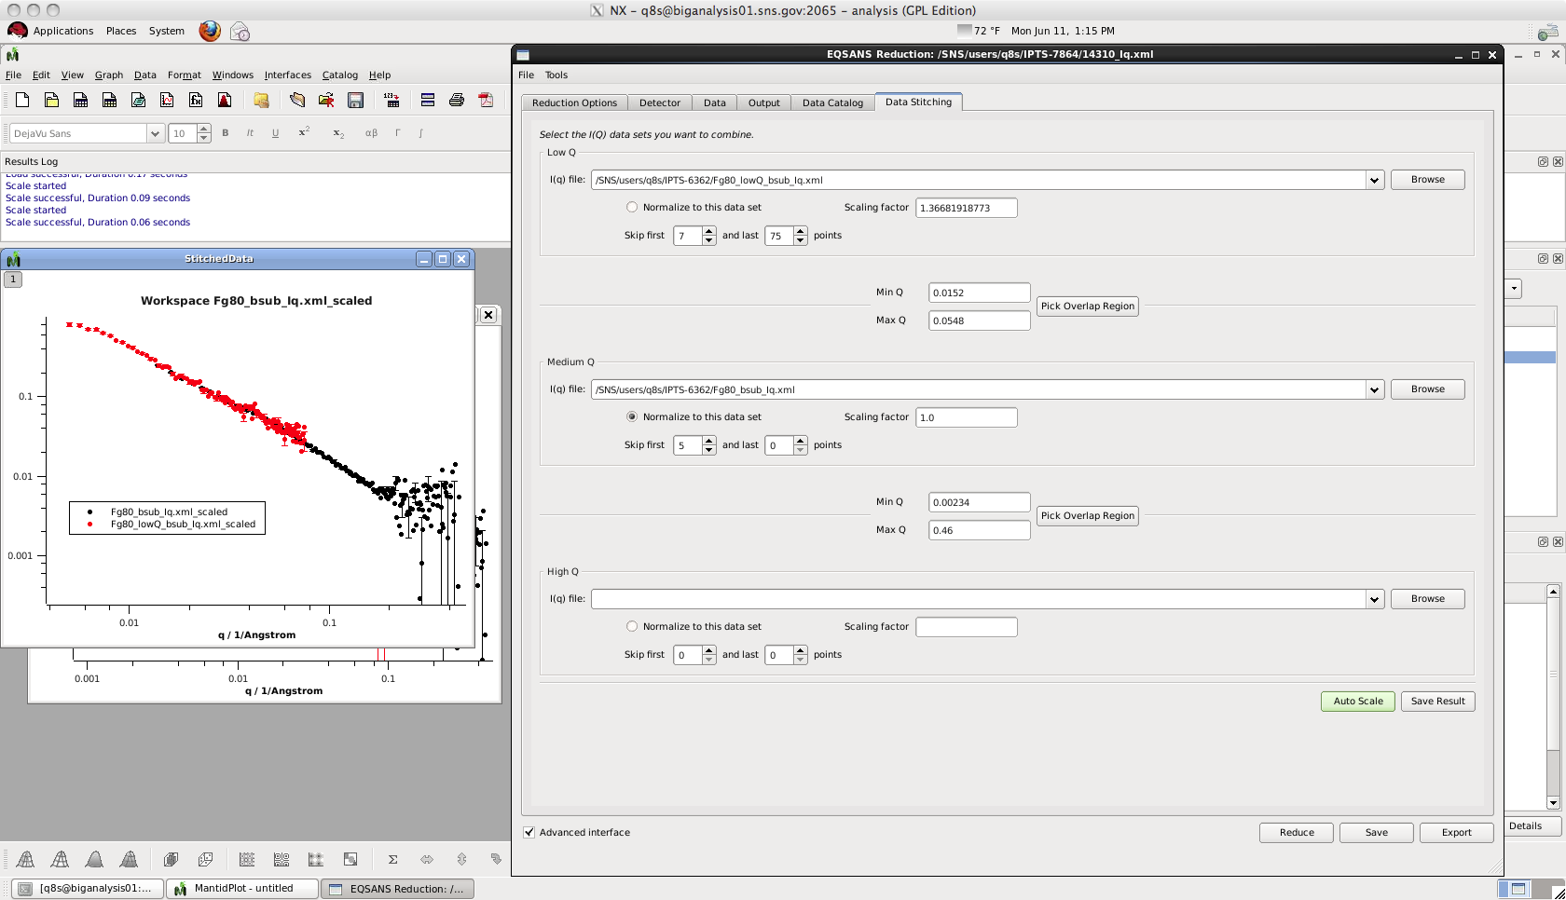
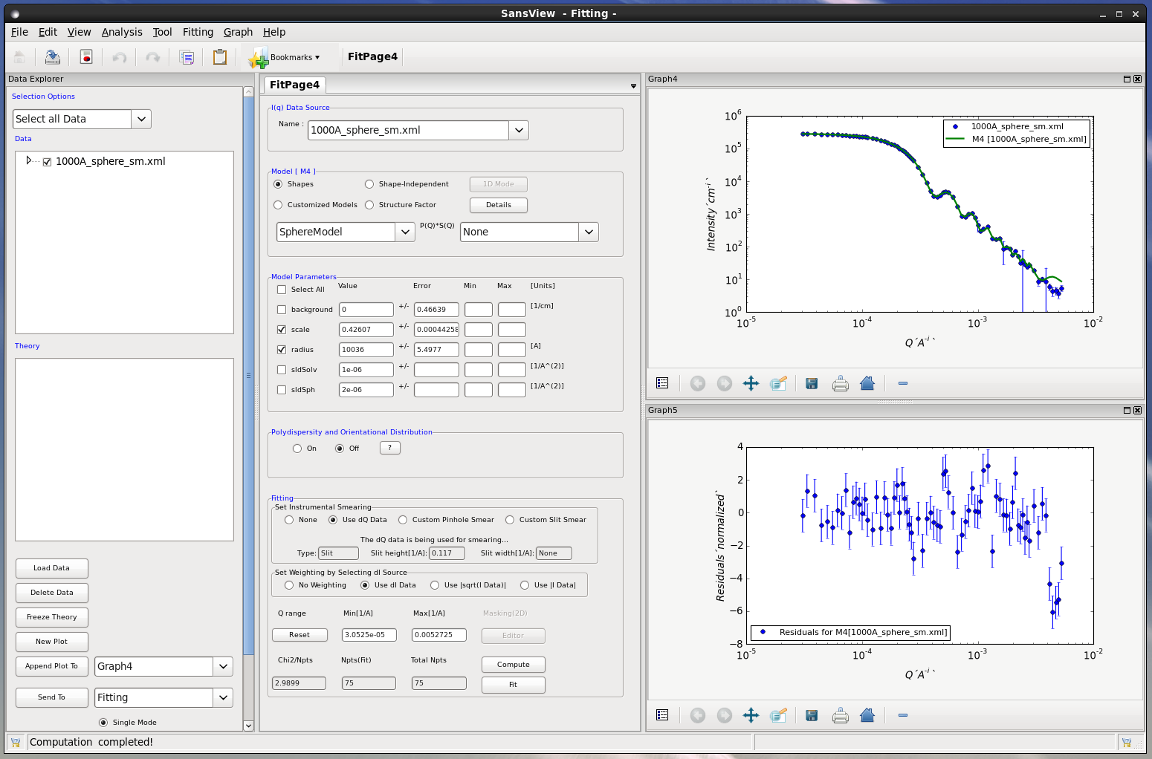
EQSANS Reduction
After reduction, Mantid can stitch data sets and write them out in formats that other analysis tools can read
SansView is one of the tools SANS users can export their data to
(see Butler et al. poster tonight)
Notes:
Growing community of users

Slide 22

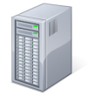








Continuous Integration Environment
Mantid Project Wiki
http://download.mantidproject.org
Deploy to
download site
Automated system tests
Code repository
Continuous integration server
Issue
tracking
system
Build + unit tests
Developers
Notes:
Commit against a ticket (repo won’t take the commit otherwise)
If you break the build, you get a nastigram

Slide 23

Deployment Schedule
Three versions of Mantid are deployed simultaneously:
Every few months:
Official Mantid releases
http://download.mantidproject.org
Unit tests
System tests
Manual testing for each ticket
Every day:
Nightly builds
Unit tests
System tests
Instrument & analysis
computers
Every couple of hours:
Development builds
Unit tests
This allows us to balance stability against the need to address urgent improvements on a given instrument.

Slide 24
Why Should Other Facilities Consider Mantid?
Leverage other people’s work.
Consider SNS:
15 to 20 developer-years had been put into the project when SNS joined.
About the same amount has been put in since then.
All instruments at the SNS can run Mantid for reduction.
Mantid supports reduction for BIOSANS and GPSANS at HFIR.
The support for all those instruments was achieved within two years.
Typical development timescale from start to user exposure:
EQSANS: ∼6 months, very stable after a year
Liquids Reflectometer: ∼5 months
Preliminary support for the SANS instrument at LENS
(collaboration with Xin Li and Roger Pynn)
Notes:
LENS = 2 days for a first cut
If instrument is close to an existing SNS instrument, very little time is needed

Slide 25
Why Should Other Facilities Consider Mantid?
Good design takes time.
When badly managed, the design phase often means design-by-committee… and leads to disaster.
Framework design is your main risk factor.
If you can use an existing framework, you should do it.
Minimizes your risks.
Saves precious time to concentrate on getting stuff done
Having an established framework from the start greatly simplifies managing the development.
Developers love to argue about design…
You get the development infrastructure for free (build servers, etc…)
Notes:
Main risk is upfront, and has long-term repercussion, and is often mis-managed (not specific to research software)
Development infrastructure takes time too!

Slide 26
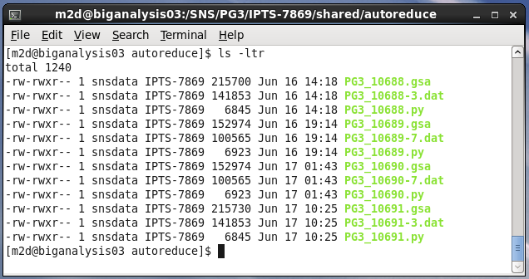
Automated Reduction @ SNS
Data taking
Nexus file creation
Archiving & cataloging
Automated reduction
Reduced data cataloging
Since all instruments share a common framework, all are now automated reduction capable.
Experiment shared area
Instruments currently running automated reduction:
POWGEN
SEQUOIA
BASIS
The more meta-data you have, the more you can automate
Notes:
Now focusing on how to make things easier for people

Slide 27
What’s next?
Mantid is a central part of the software infrastructure we are building to provide:
The ability to reduce, and analyze, the data as it is taken
Data files created instantly after acquisition
The ability to reduce a data set post-acquisition in minutes
The resources for any user to do post-acquisition reduction, analysis, visualization, modeling from anywhere
Notes:
Stream the data and access it before the end of the run
Instrument <= 4GB/sec
See your I(q) building itself live

Slide 28
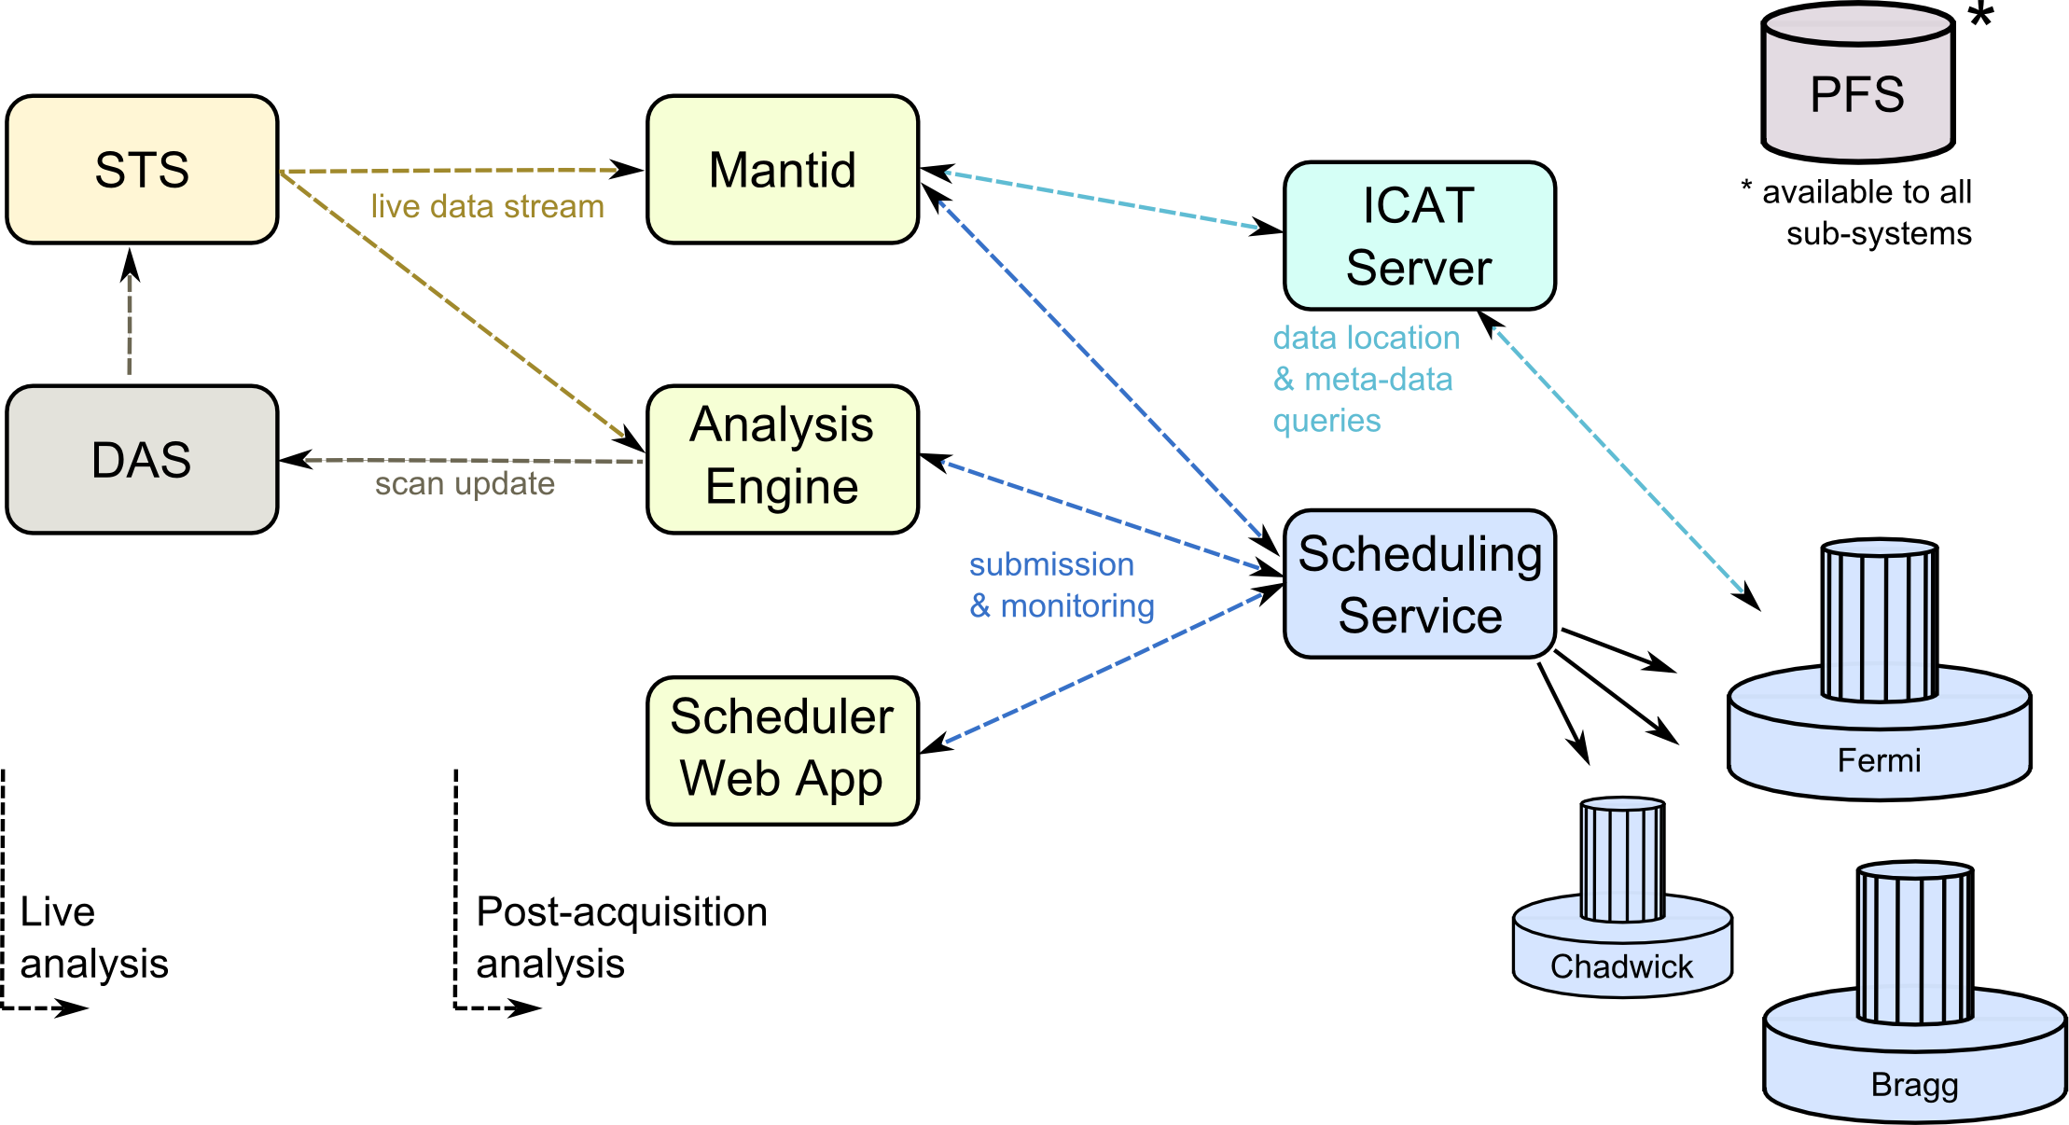
Future of Data Analysis Infrastructure
Putting it all together
Notes:
Decision support

Slide 29
Summary
Two years after adopting Mantid, all SNS instruments can run Mantid for reduction.
In retrospect, using an existing framework with a proven track record was a wise decision.
The focus is now shifting towards live data streaming, reduction and analysis.
Stick around for Andrei Savici’s talk later in this session.
http://download.mantidproject.org/
For more info:
Mark Hagen – Group leader
Stuart Campbell – Inelastic analysis team leader
Pete Peterson – Diffraction analysis team leader
Mathieu Doucet – Low-Q analysis team leader
Nick Draper – Mantid project manager at ISIS

